Slide 1

Application Insights Lightning Talk
Martin Kulov
Association of Software Engineers
Tweet @AppInsights

Slide 2

Agenda
Why do I need Application Insights?
What is it?
Main Areas
Summary
Questions…

Slide 3
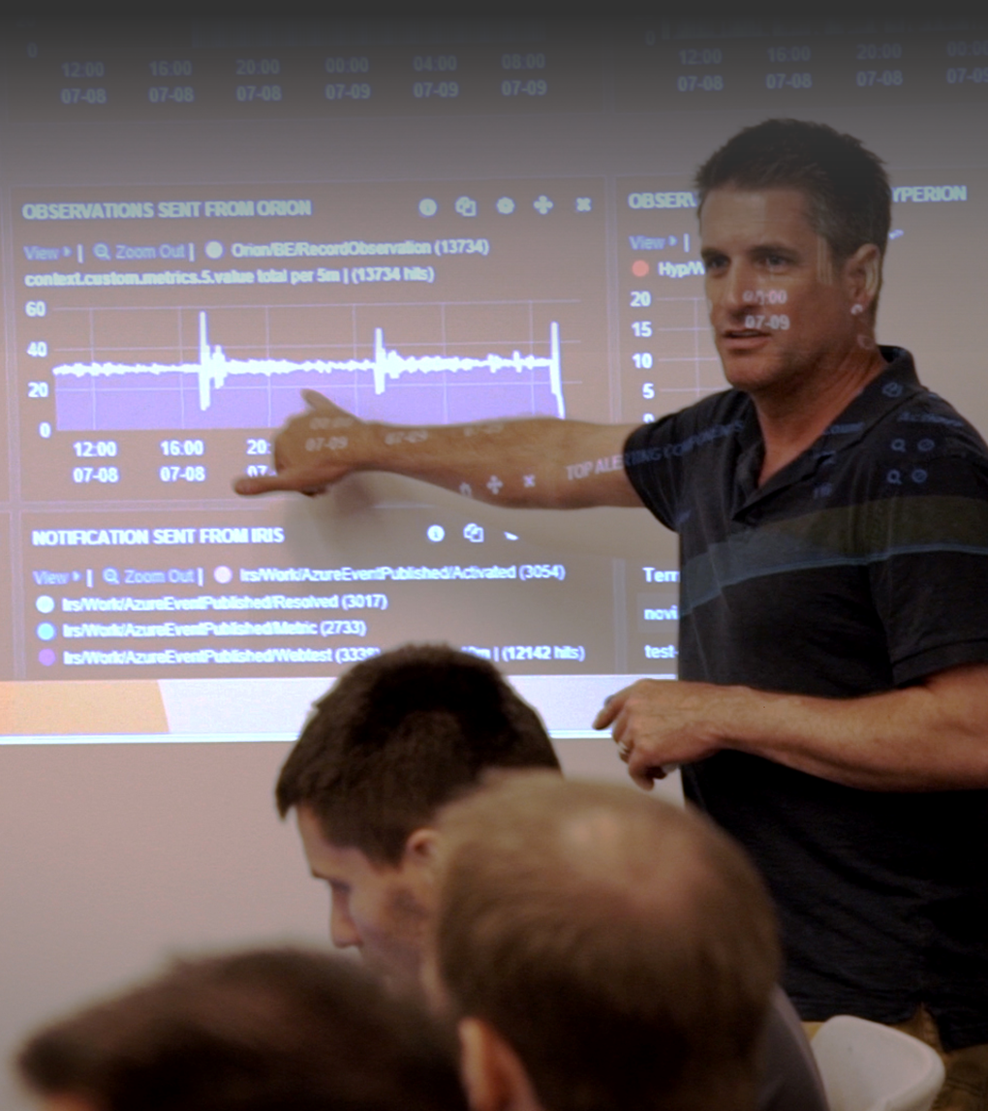
Answer questions like …
Is my application crashing?
What exactly happened?
Is my application fast enough?
Is my server able to handle the load?
How responsive are my dependencies?
Is my application UP or DOWN?
What is the root cause?
How many people are impacted?

Slide 4
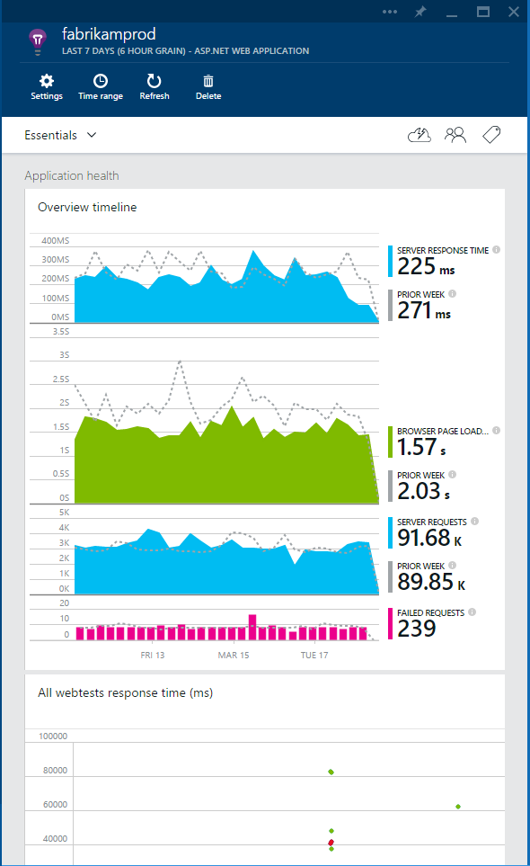
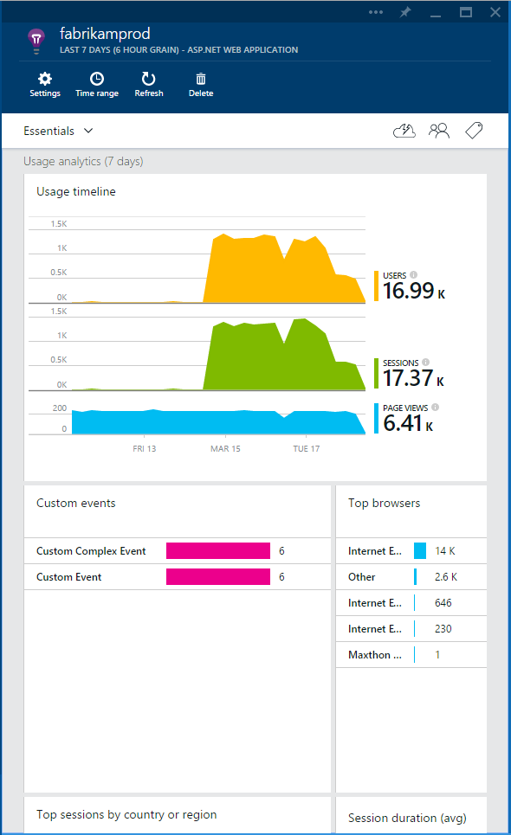
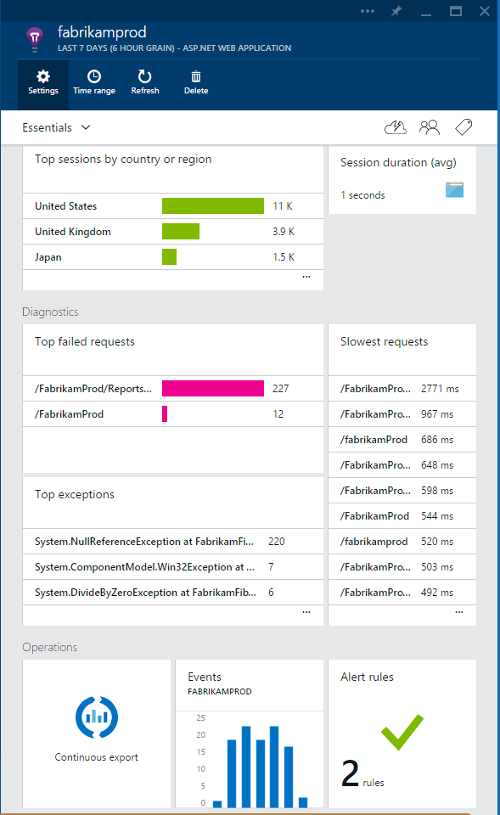

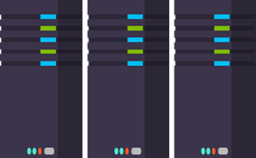
What is Application Insights?
3
Identify, understand and resolve issues with powerful out-of-the-box and custom telemetry
1
Telemetry is collected at each tier: server backend, middleware, web service & browser
2
Telemetry arrives in the cloud where it is stored & processed

Slide 5
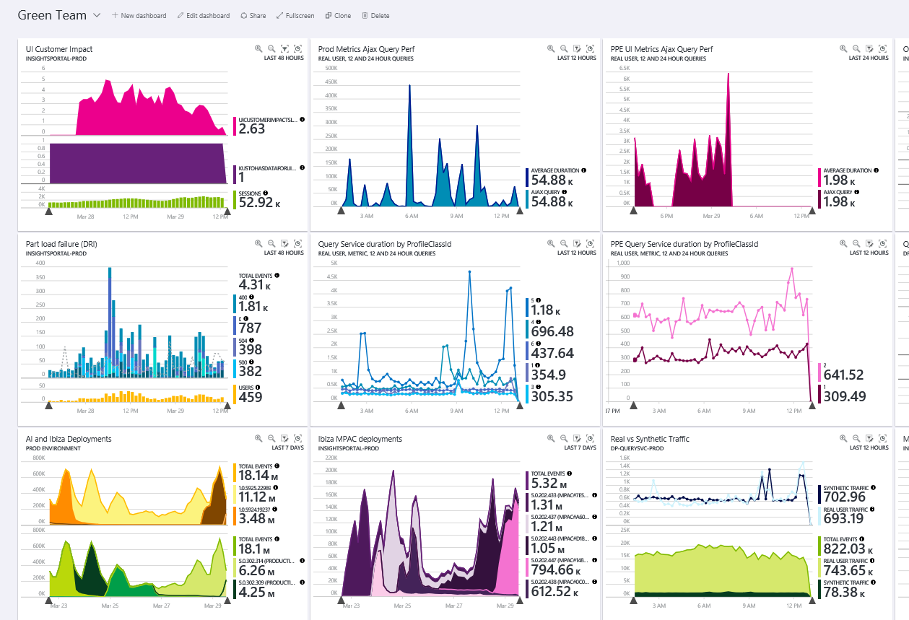
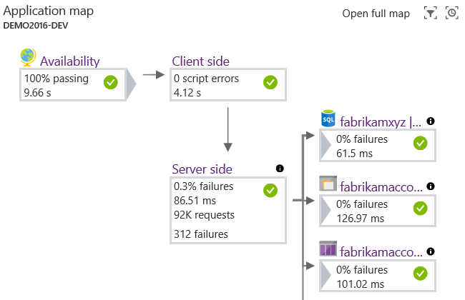
Intelligent APM: Detect, Triage & Diagnose
Detect
Proactive alerts, dashboards and live metrics stream
Triage
Application map and real user impact
Diagnose
Exceptions, performance issues, dependency failures and Azure role lifecycle issues
Operationalize
Alerts based on metrics/events/APM data with Webhooks support
Notes:
There are a bunch of interesting new capabilities so lets get started with the first area: Intelligent APM
As modern app developers, we all know how crucial it is to detect, triage and diagnose problems before they start affecting our customers. With Application Insights you get all the tools to make your diagnostics experience smarter and find and fix problems before your customers know it!
Detect: One of the most crucial things is to be able to detect issues as soon as they happen, and be alerted instantaneously. However, the issue with alerts is that it requires you to have a threshold and more often than not, you don’t have any idea. Moreover, in the complexity of modern app architecture, even an army of analysts sitting in front of a dashboard cannot detect all the different things that can go wrong. That is where proactive diagnostics come into play. With our Machine Learning based technology, you can be alerted on real time service disruptions and anomalous patterns in your app performance and behavior, with thresholds constantly evolving based on your app architecture and performance patterns.
With dashboards you can pin all the charts and KPIs across your Azure resources at a single place and share with your colleagues. You can also take advantage of the new live stream metrics to see what is going on with your application metrics at this right very moment.
Triage: Once you detect an issue, the next thing is to figure out its impact and whether it is priority enough to solve right now. With Application insights you can find out the real user impact of any exception and take decisions accordingly. With the new Application Map you can automatically detect your application topology across dependencies and client & server side components. You can find the impact assessment and click through to underlying Azure resources to find the right information.
Diagnose: Once you decide to fix an issue, you need all the context to solve it, and with our out-of-the box telemetry collection, you will have all the data you need. What’s more, if you are developing Azure Cloud Services or App Services, you can get much deeper diagnostics information, covering some of the role lifecycle issues and other performance problems. Operationalize: Once you have been through the Detect, Triage & Diagnose cycle, you can set up your own custom alerts based on the thresholds you discovered and keep being on top of things!

Slide 6
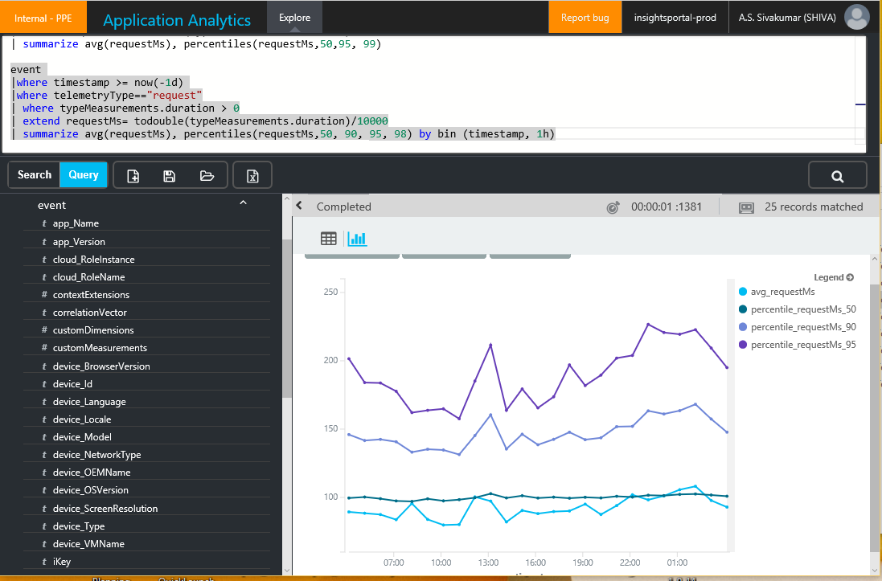
Ad-hoc queries and interactive analytics
Diagnosing across app stack is hard unless various perspectives connected
New and powerful big data query engine for all your app telemetry and root-cause analysis
Ad-hoc queries and full-text search helps answer tough questions instantly
Notes:
OK! So, lets get to our next area: Analytics
As we mentioned in the beginning, Analytics is a new capability in Application Insights we just announced at Build. And, I should say it is one of my most favorites.
In a modern app architecture with various tiers and components, it is often very difficult to diagnose problems or gaps across the entire app stack unless you can connect the various perspectives.
With our new big data query engine, you can do that very easily and find all the answers to do the root-cause analyses.
You can ask ad-hoc queries across your entire app telemetry and even do full text search to discover the right data sets.

Slide 7
Powerful query language
Service Performance
Transaction response time
DB response time
Exceptions
CPU and memory utilization
Data center location
Simple, powerful SQL like language much easier for complex queries
Filter, join and correlate data to gain performance & usage insights
Extract and extend your data to create new calculated data fields
Generate statistical aggregations and powerful visualizations instantly
App & Business Metrics
Custom events
Custom dimensions
App KPIs
Conversion rates
Customer Experience
Response time
Errors
Geo location
Browser type and version
Session
Notes:
What powers the Analytics experience is a powerful query language we launched as well.
Read through the points…
And the best thing with Application Insights is that since we collect telemetry across your application stack, you can correlate data across your Service Performance, Business Metrics and Customer Experience and generate unique insights helping you answer tough questions almost instantly.
To put it in perspective, some very high scale Microsoft services are using it today sending us Terabytes of data over which they can get answers to their queries in as little as a few seconds. E.g. internally the service ingests over 1 trillion events and 600TB a day of log data across hundreds of Microsoft cloud services. Yes, 600TB a day – that’s many petabytes of retained log storage in just one month.

Slide 8
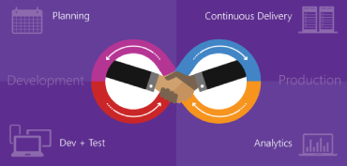
DevOps integration
Diagnose problems right from within your dev environment
Integrate with existing DevOps workflows in Visual Studio & VSTS
Visual Studio 2015 (Update 2)
Seamless Trace Collection; Search Production Telemetry; Diagnostics Hub; Jump to Code
Visual Studio Team Services
Release Annotations; Cloud Load Testing; Work Item Tracking
Notes:
Lets switch gears to our 3rd area: DevOps. As developers we would be using one or the other dev environment and have some DevOps workflows that we would be using! Having the diagnostics experience integrated with our existing practices makes it so very easy and useful! If you use Visual Studio or Visual Studio Team Services, there are a bunch of integration points that you can take advantage of.

Slide 9
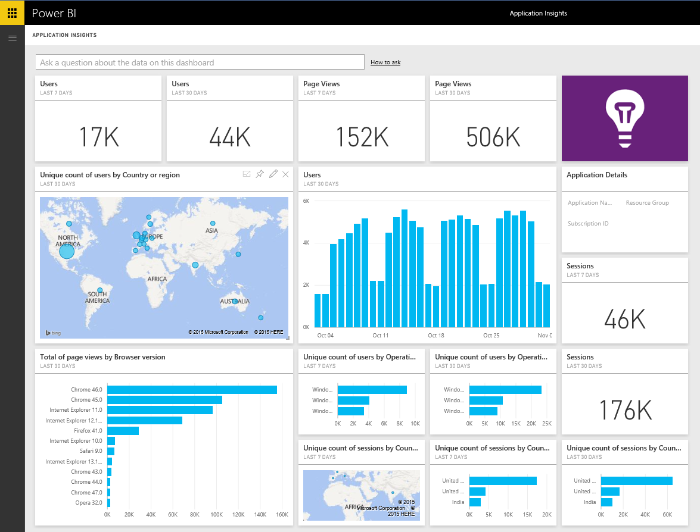
Flexibility and extensibility
Open Source SDKs to power insights for any web app
Continuously export data to Azure Blob Storage or SQL
Visualize data with Power BI Content Pack
Data access via REST APIs
Notes:
What also makes Application Insights powerful is how it is designed to be flexible and extensible to help you get insights suited to your particular needs.

Slide 10
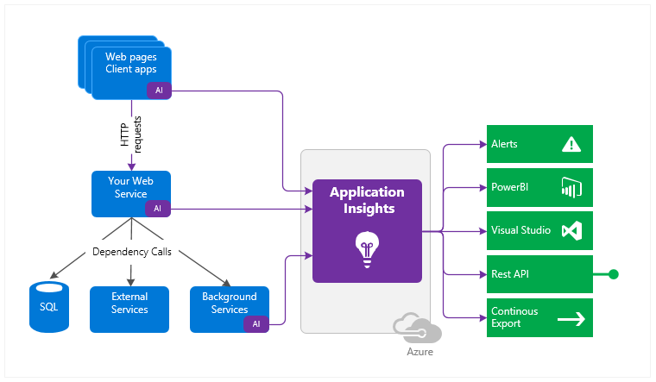
AppInsights High Level Diagram

Slide 11
Cross Platform

Slide 12
Languages
C#
Java
JavaScript

Slide 13
Platforms
Angular
ASP.NET
ASP.NET Core
Android (HockeyApp)
Azure Web Apps
Azure Cloud Services
Azure Functions
Docker
Glimpse
iOS (HockeyApp)
J2EE
Mac OS X app (HockeyApp)
Node.JS
OSX
Spring
UWP
WCF
WPF (HockeyApp)
Windows desktop

Slide 14
Client Side

Slide 15
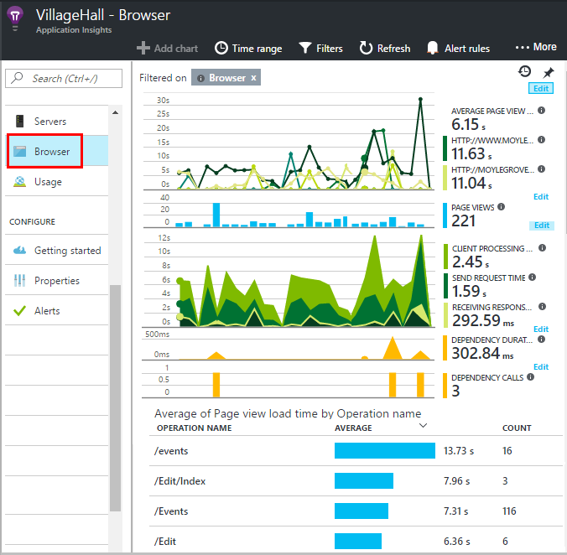
Web Pages

Slide 16
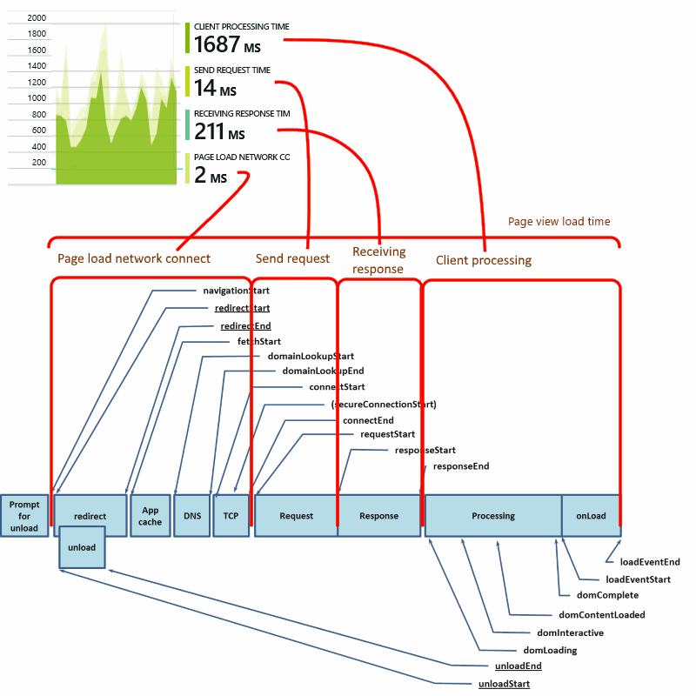
Page Load Performance

Slide 17
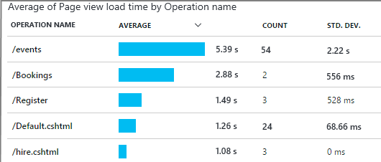
Loading Times

Slide 18
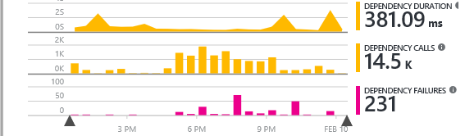
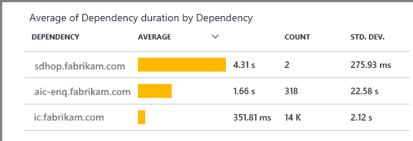
AJAX Performance

Slide 19
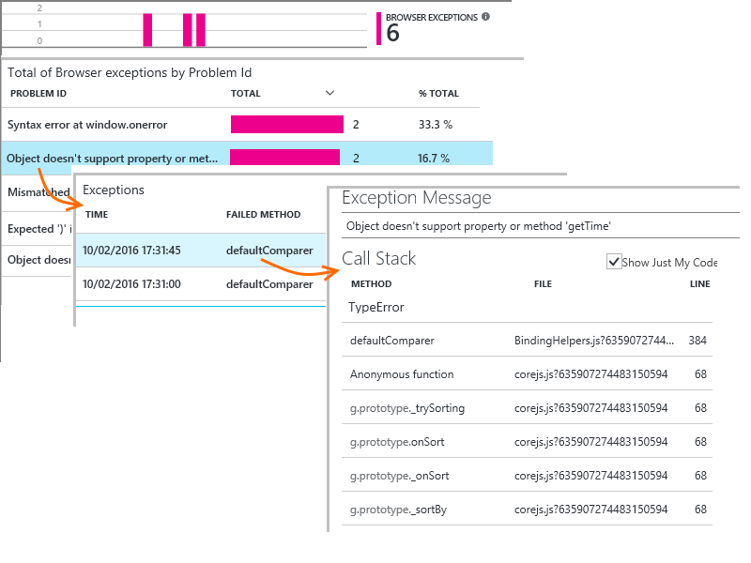
Browser Exceptions

Slide 20
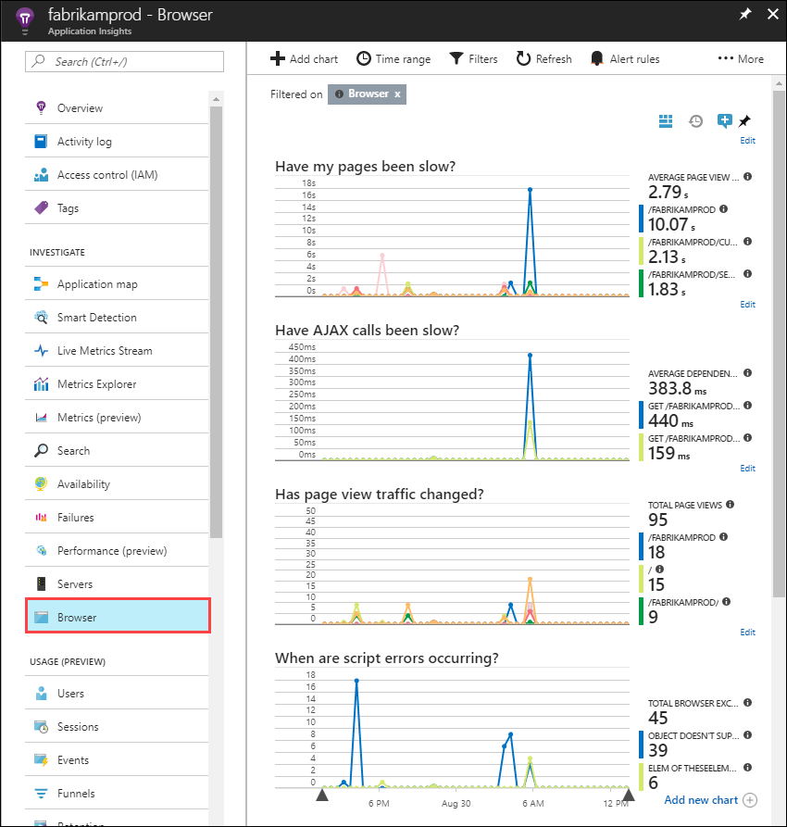
Browser

Slide 21
Server Side

Slide 22
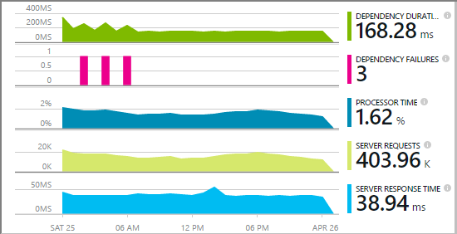
Server Metrics

Slide 23
Build Time vs Run Time
 | Build time | Run time
Requests & exceptions | Yes | Yes
More detailed exceptions |  | Yes
Dependency diagnostics | On .NET 4.6+, but less detail | Yes, full detail: result codes, SQL command text, HTTP verb
System performance counters | Yes | Yes
API for custom telemetry | Yes | No
Trace log integration | Yes | No
Page view & user data | Yes | No
Need to rebuild code | Yes | No

Slide 24
Status Monitor
Instruments IIS web server
Install from Web Platform Installer
Available as Azure Extension
Uses CLR Profiler for dependency calls

Slide 25
Logs

Slide 26
Logging Frameworks
Log4Net, NLog, or System.Diagnostics.Trace
Java, Log4J, or Logback
Semantic Logging (SLAB)
Cloud-based load testing
LogStash plugin
OMS Log Analytics
Logary

Slide 27
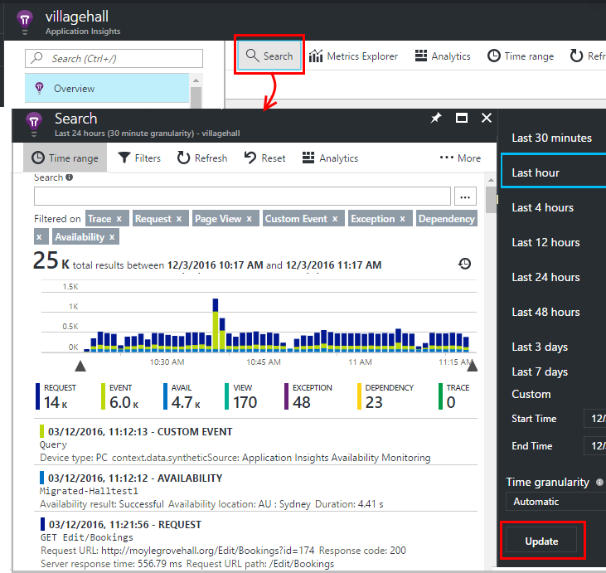
Search

Slide 28
Snapshot Debugger

Slide 29
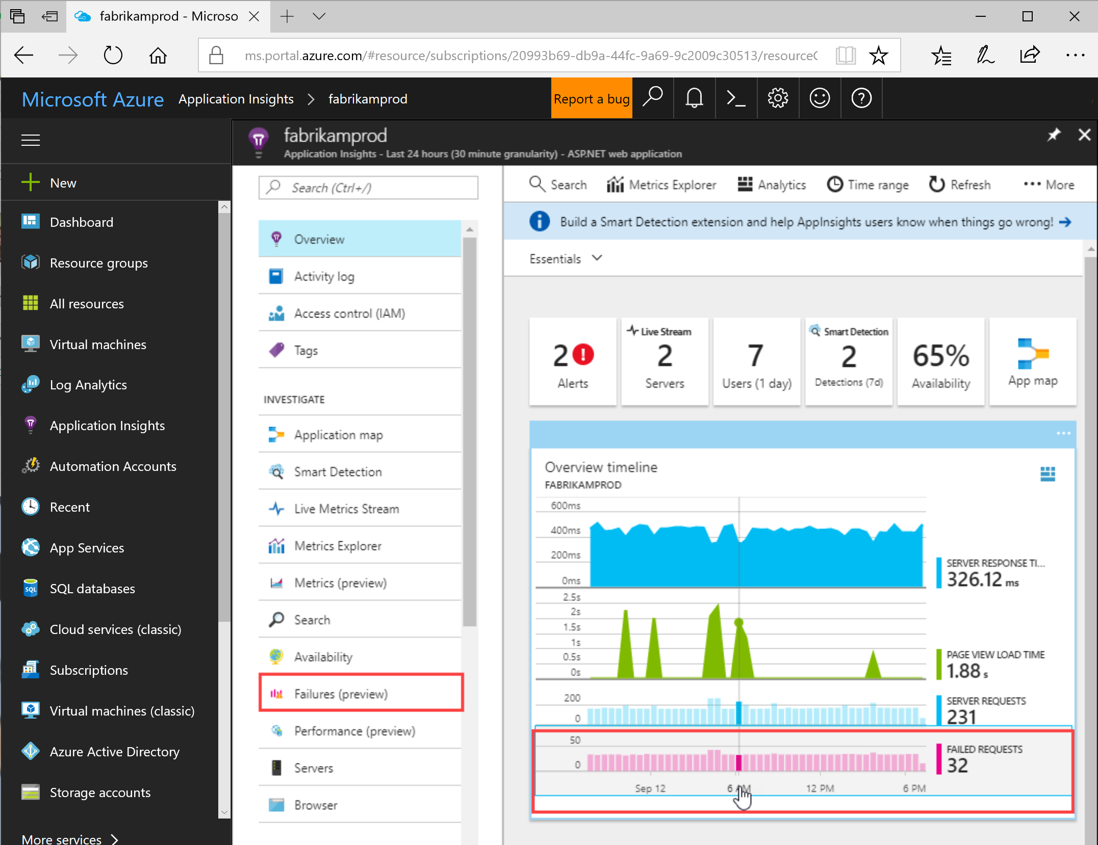
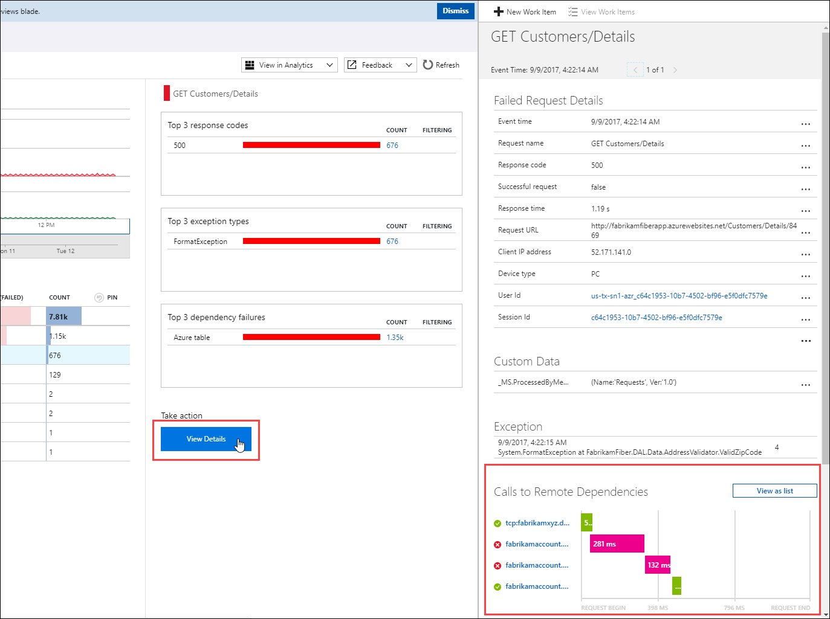
Identify Failures

Slide 30
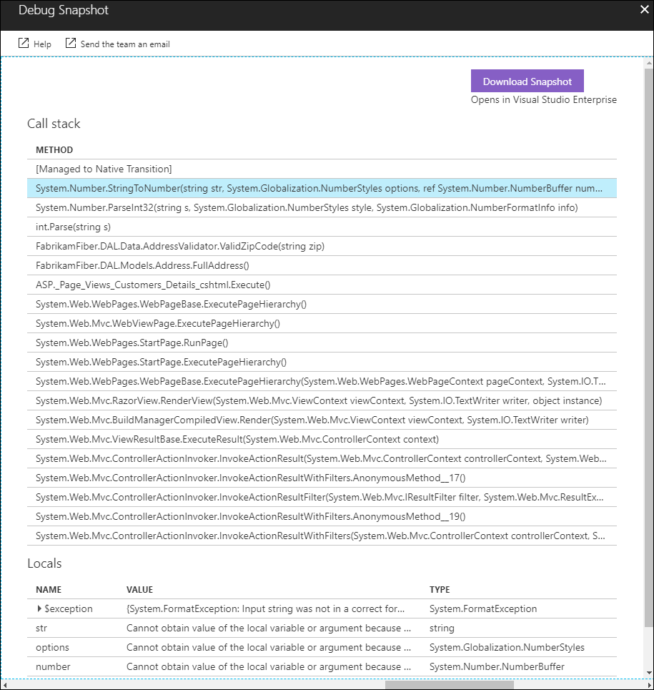
Download Snapshot

Slide 31
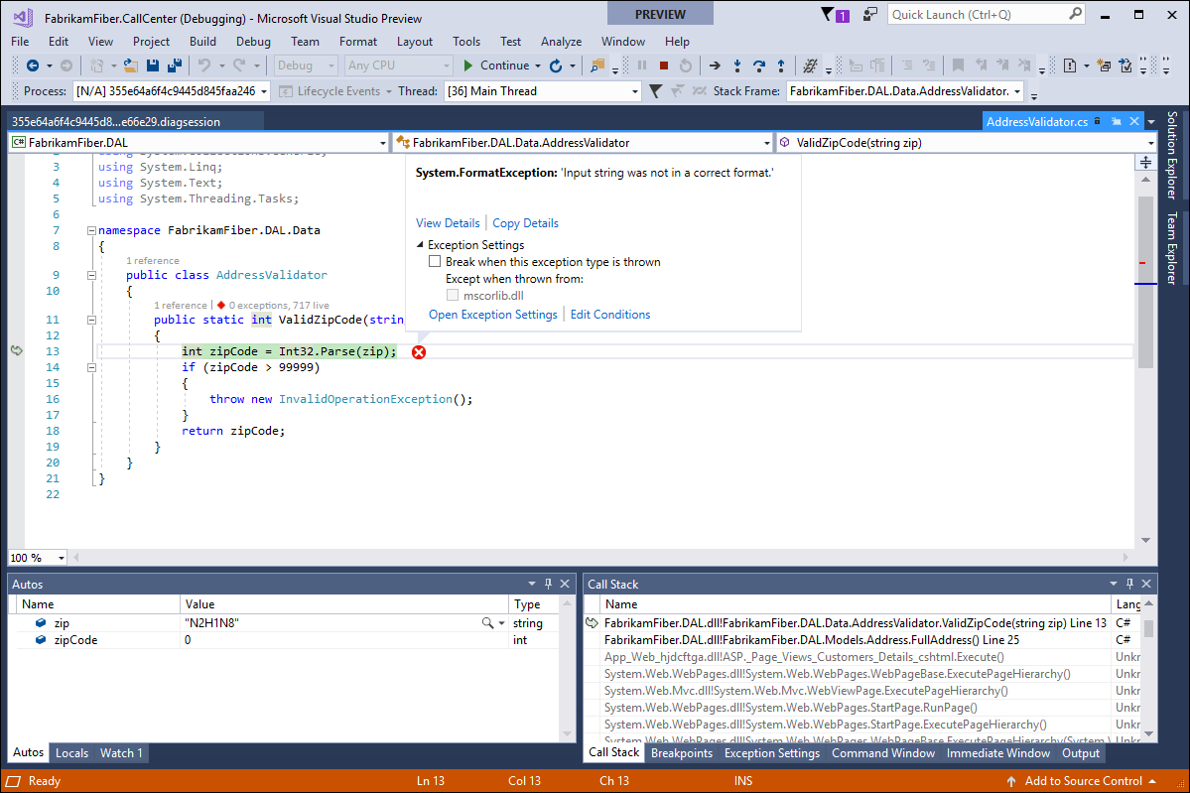
Debug Snapshot

Slide 32
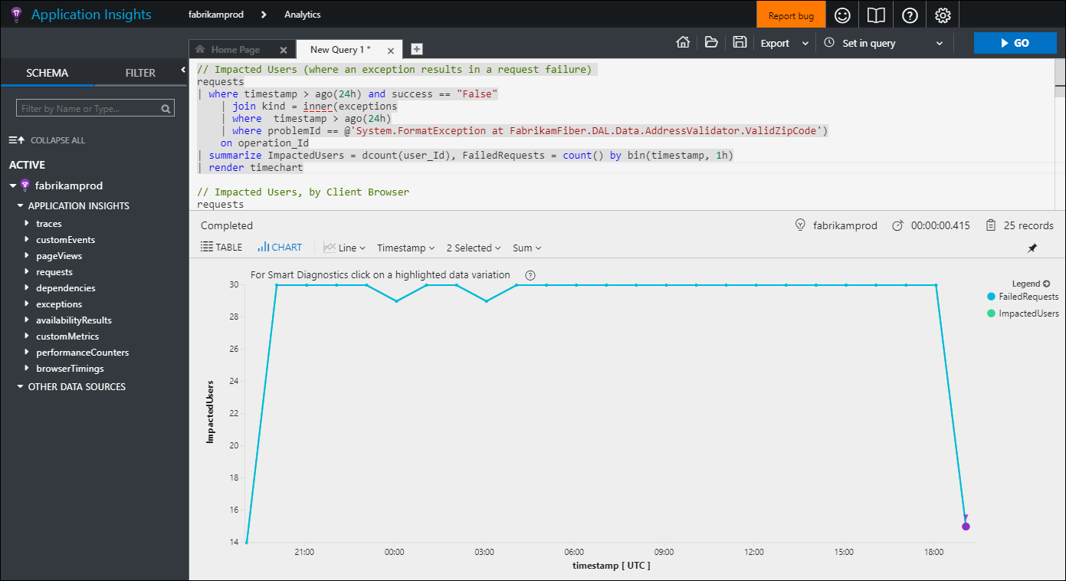
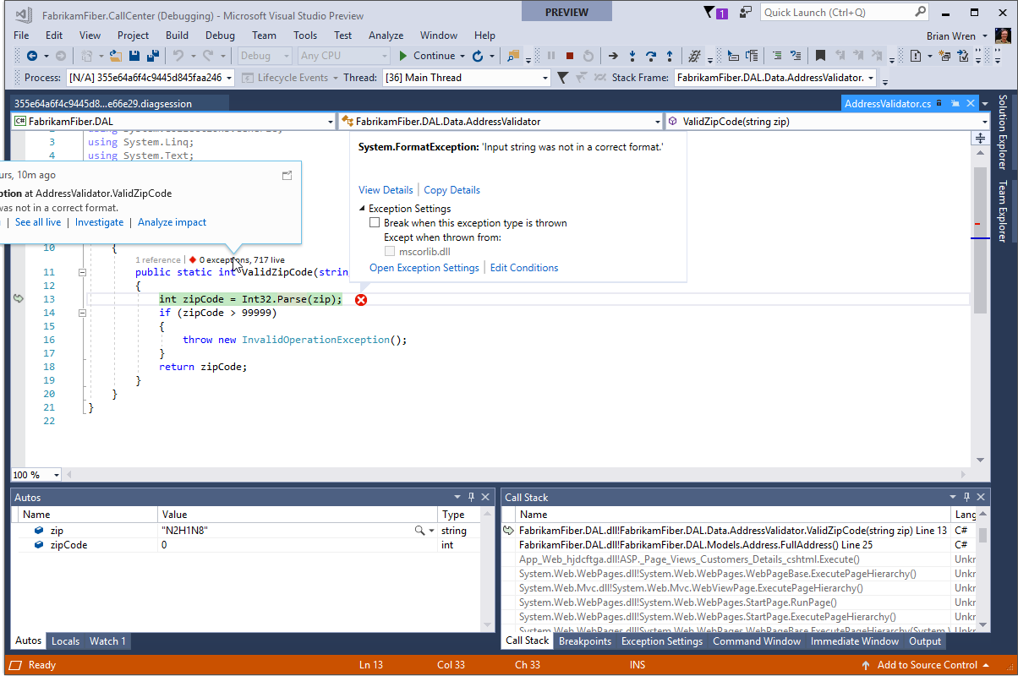
Analyze Impact

Slide 33
Performance Profiler

Slide 34
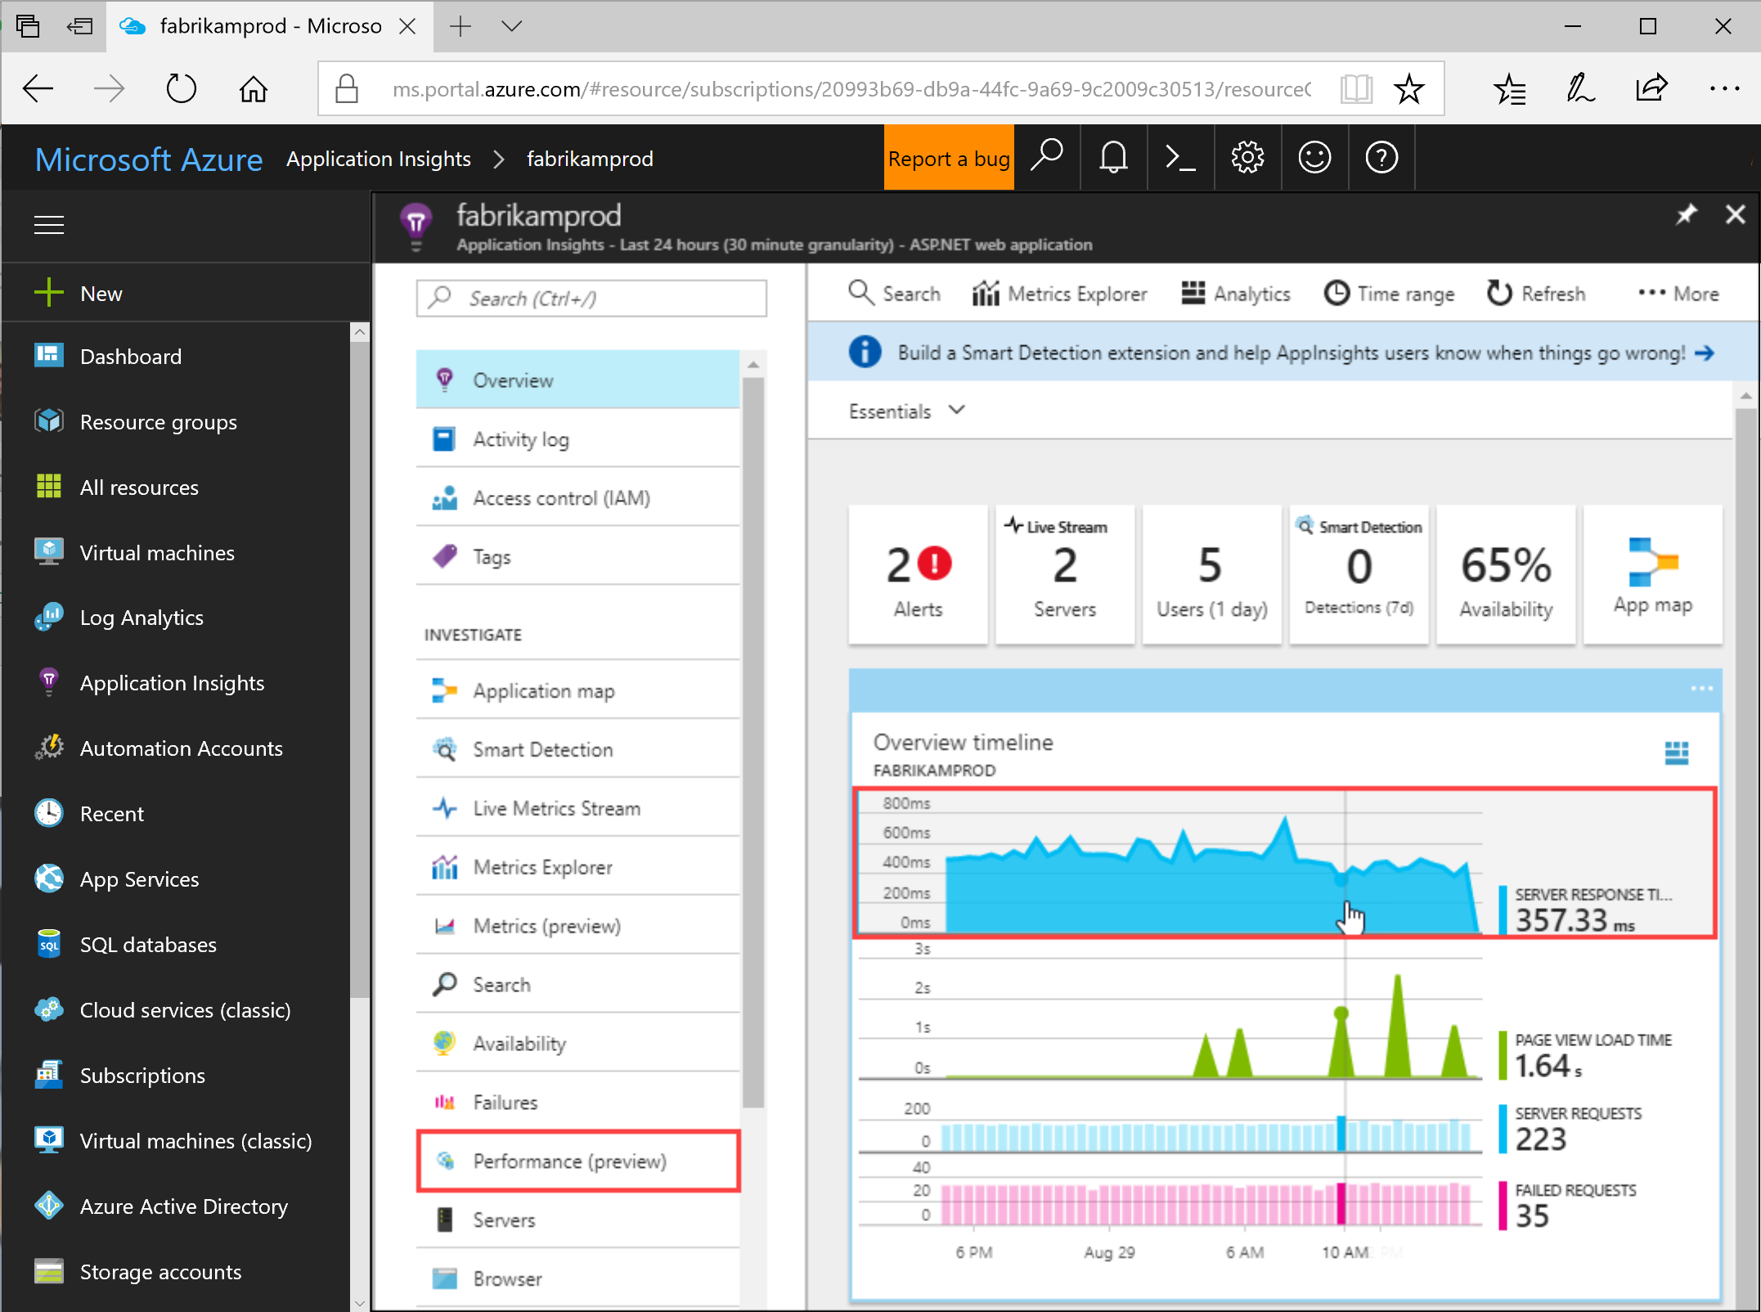
Server Response Time

Slide 35
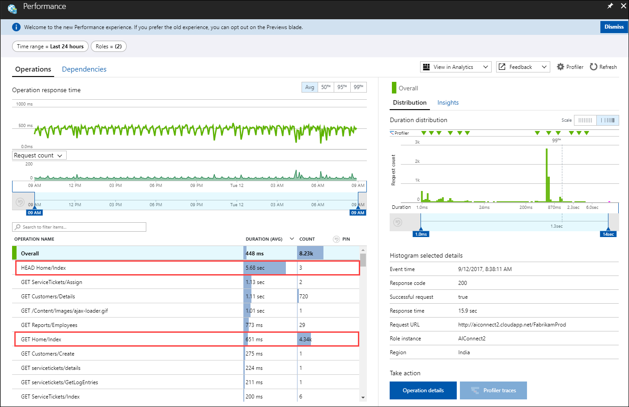
Performance

Slide 36
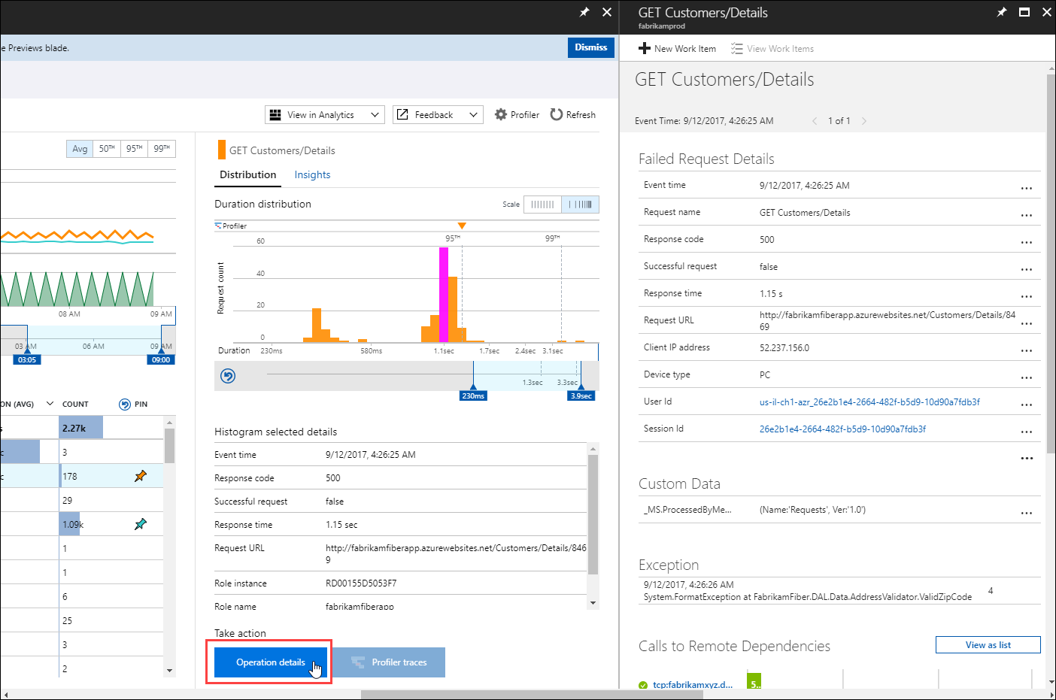
Operation Details

Slide 37
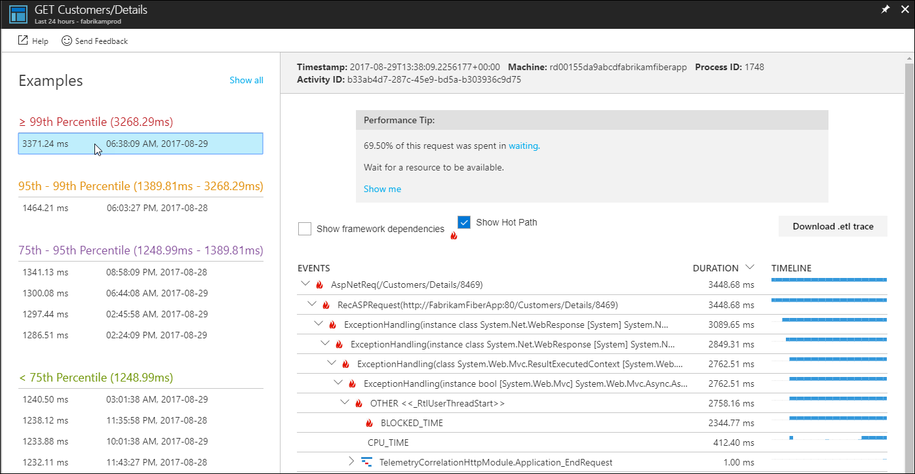
Show Hot Path

Slide 38
Smart Detection

Slide 39
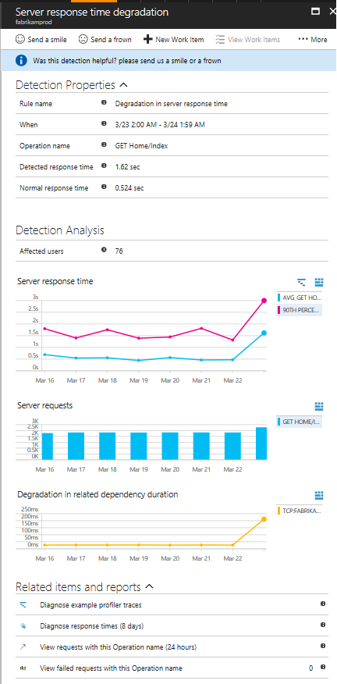
Smart Detection
Response Time Degradation
Dependency Duration Degradation
Slow Performance Pattern

Slide 40
Application Map

Slide 41
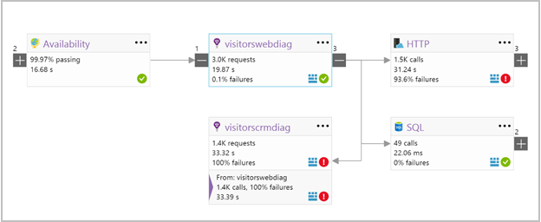
Application Map

Slide 42
Telemetry

Slide 43
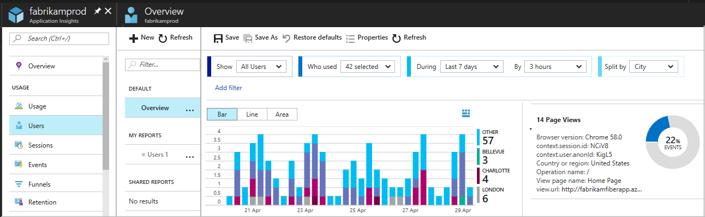
Demographics and Statistics

Slide 44
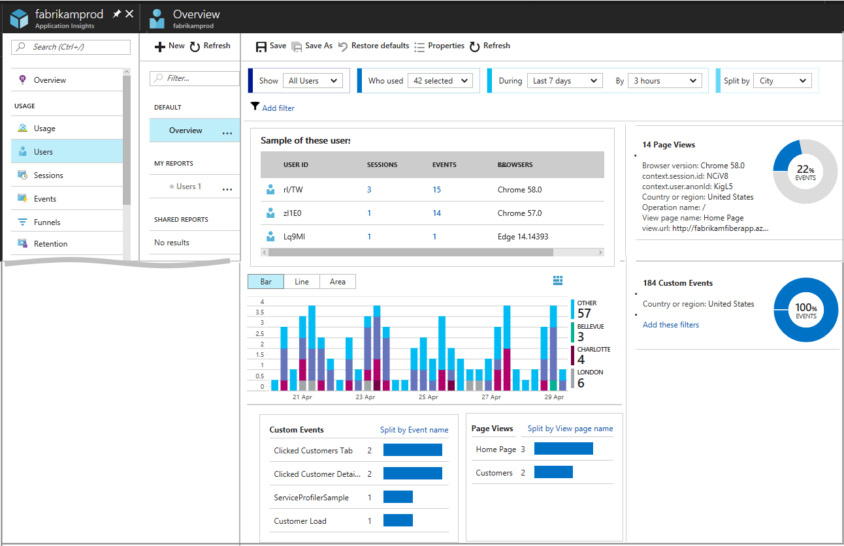
User, Sessions, Events

Slide 45
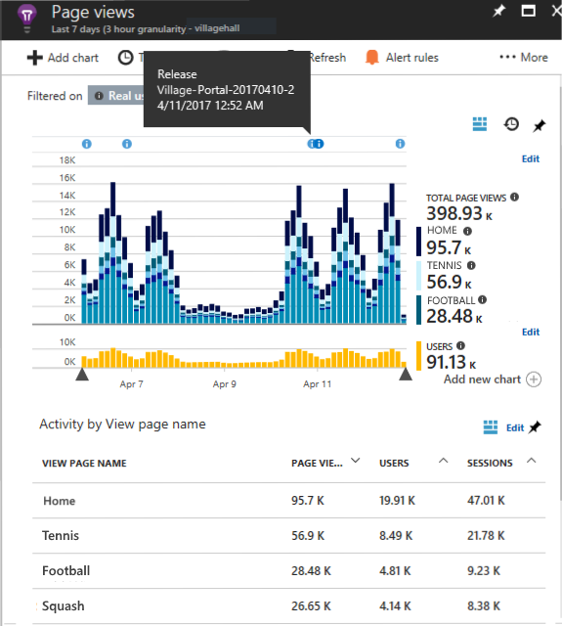
Page Views

Slide 46
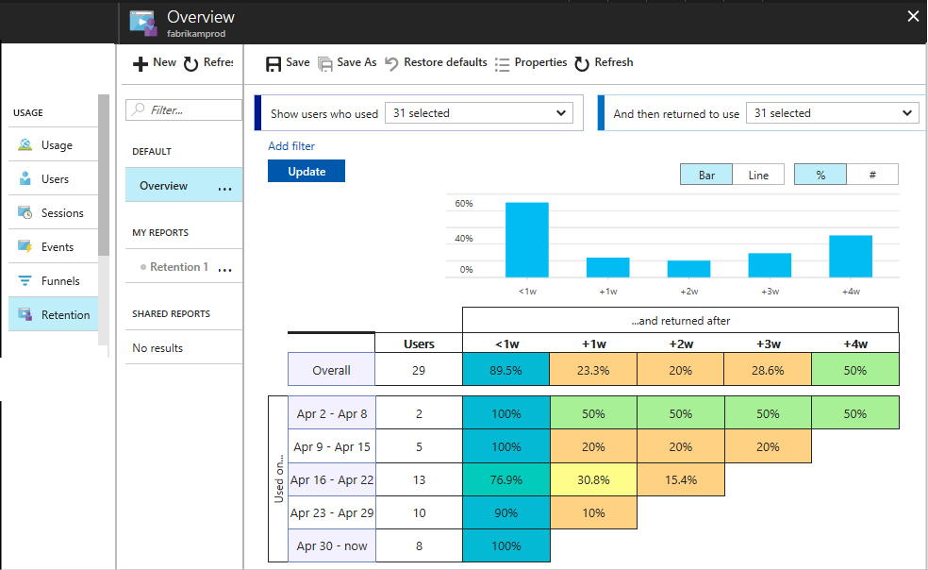
Retentions

Slide 47
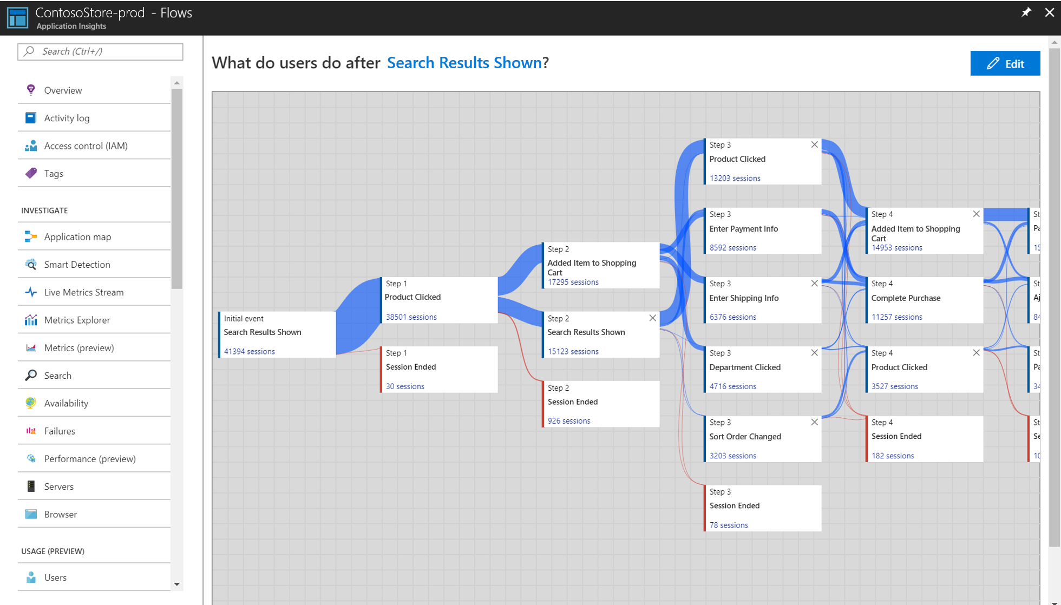
User Flows

Slide 48
Analytics

Slide 49
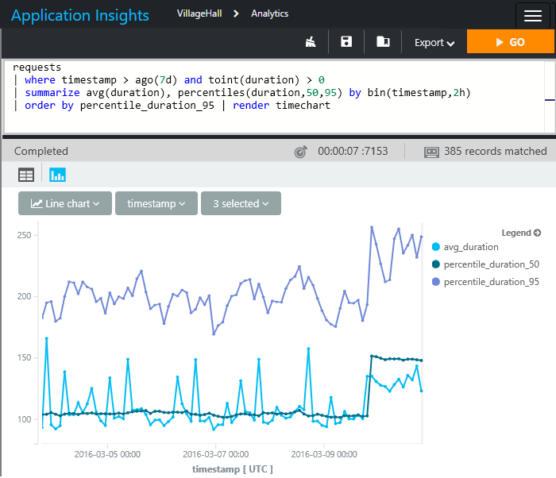
Analytics

Slide 50
Some questions you might have…
Privacy & Security
Data storage
Performance impact
Customer support
And … it’s FREE to get started!

Slide 51
Thank you!
Martin Kulov
martin@kulov.net

